Slide 1

Line Graphs
Connects a series of points through line segments
Points are ordered (Usually along X-axis)
Useful in identifying trends in the data
Syntax: plot(v,type, col,xlab, ylab)
v is a vector containing the numeric values
type takes the value "p" to draw only the points, "l" to draw only the lines and "o" to draw both points and lines.
xlab is the label for x axis.
ylab is the label for y axis.
main is the Title of the chart.
col is used to give colours to both the points and lines.

Slide 2
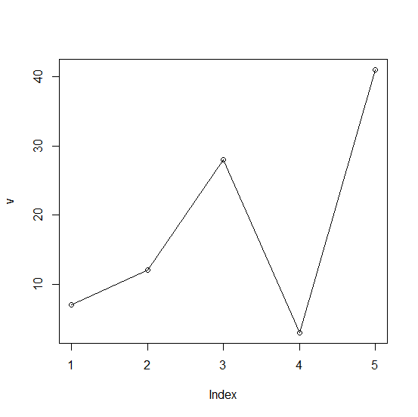
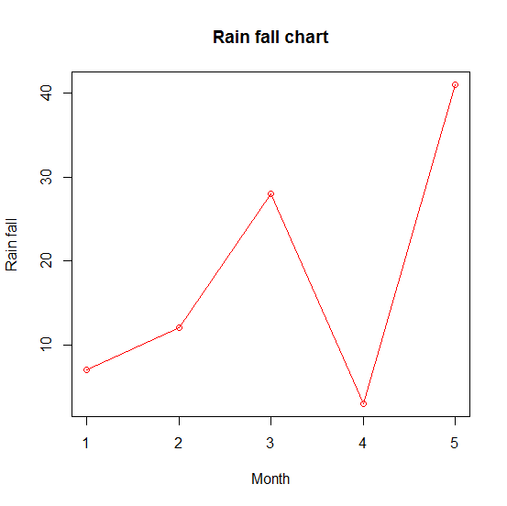
Line Graphs: Example
# Create the data for the chart.
v <- c(7,12,28,3,41)
# Plot the bar chart.
plot(v,type = "o")
# Title, Color and Labels
plot(v,type = "o", col = "red", xlab = "Month", ylab = "Rain fall", main = "Rain fall chart")

Slide 3
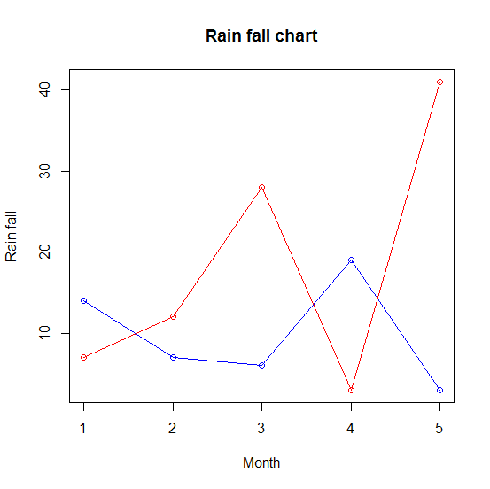
Line Graphs: Example
# Create the data for the chart.
v <- c(7,12,28,3,41)
t <- c(14,7,6,19,3)
# Plot the bar chart.
plot(v,type = "o",col = "red", xlab = "Month", ylab = "Rain fall", main = "Rain fall chart")
lines(t, type = "o", col = "blue")

Slide 4
Exercise -
Using the dataset ‘airquality’, attempt the following:
Plot a line graph of the mean ozone quality by month.
Draw a line graph for cricket T20 between India and Australia (use dummy data).
OzMonthMean<-tapply(airquality$Ozone, factor(airquality$Month), mean, na.rm=TRUE); barplot(OzMonthMean,col=2:6, main="Mean Ozone by month")
pie(OzMonthMean, col=rainbow(5))

Slide 5
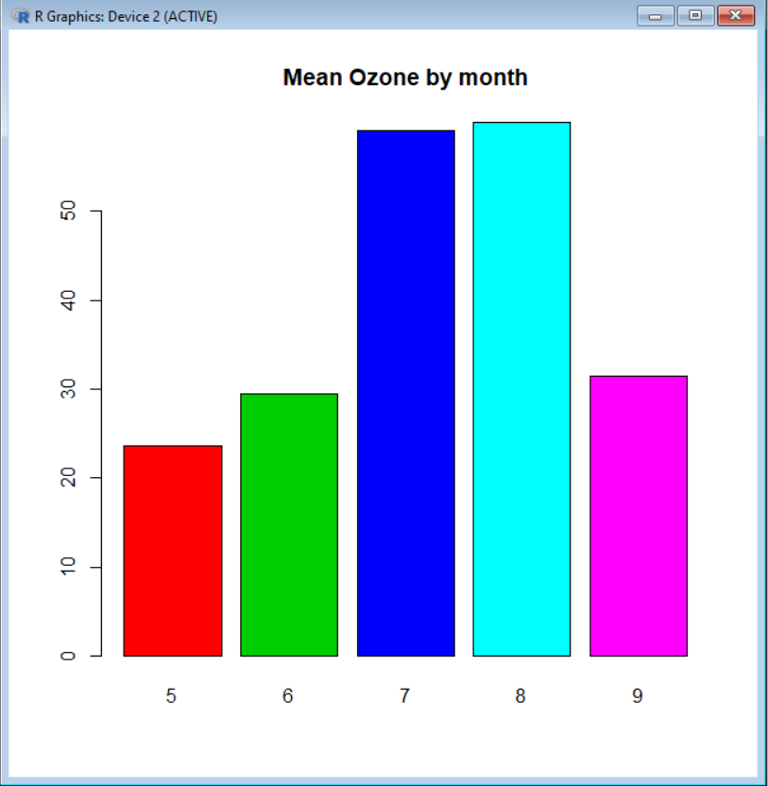
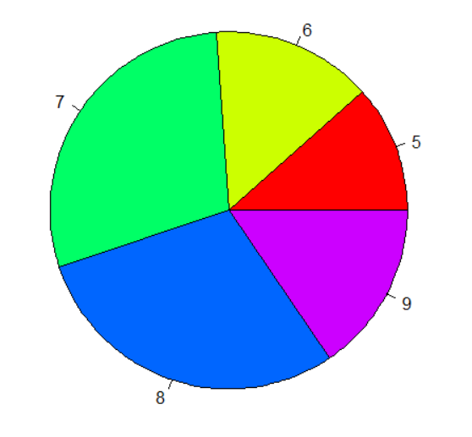
Sol. 3 Sol. 4

